Slide 1
Cryptocurrency

Slide 2
Cryptocurrency
Cryptocurrency is a digital or virtual currency that uses cryptography for security and operates independently of a central Authority. It's a distributed system that relies on a distributed ledger, typically a blockchain, to record transactions.

Slide 3
বিনিময় প্রথা (Barter system)
People
Different Products with different people
Someone need x but have y but who have y he needs z
Someone introduce Gold coin again product, everyone transact with him(sell/buy product against gold coin)
Availability of gold, risk to carry, different values of different product.
Paper Note against gold coin.
The paper not is not usable to other village!
More notes without gold creates inflation!
Foreign Exchange
Varies value of different paper note
Foreign Trade
Digital/Crypto currency
Bank
Notes:
Blockchain: https://www.youtube.com/watch?v=Ki52aCnKdpw
Cryptocurrency: https://www.youtube.com/watch?v=hgfQdM2JnNo

Slide 4
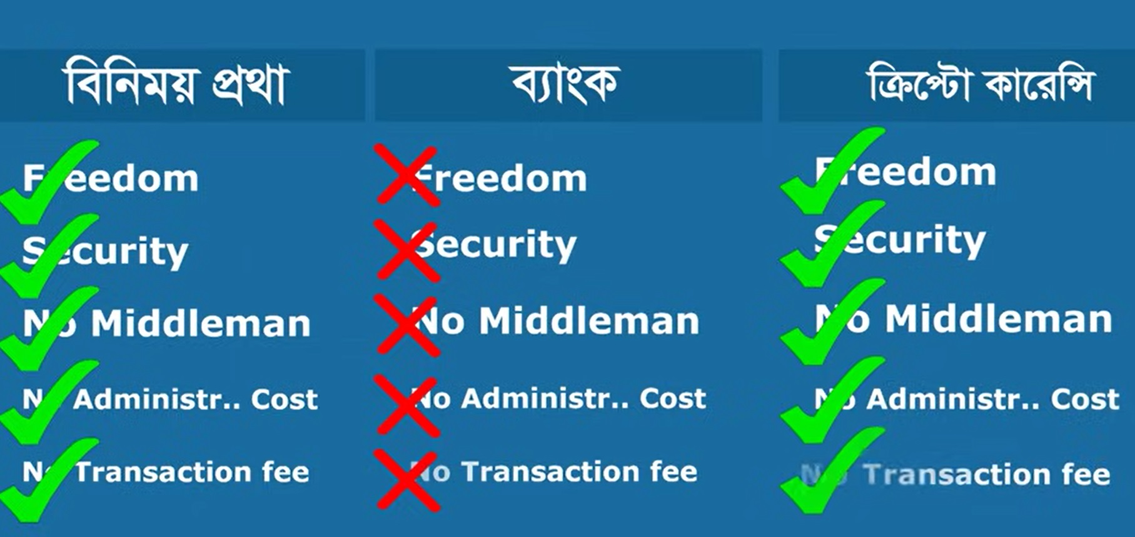
Comparison

Slide 5
bKash
Digital
KYC (Know Your Customer)
Plain data
Central Data
Central Authority
Quantity of Currency
Value of the Currency
Transaction Fee

Slide 6
Cryptocurrency: Attributes
Digital
A/C or Anonymous
Secured Data
Distributed Data
No Central Authority

Slide 7
Why Cryptocurrency?

Slide 8
Advantages of Cryptocurrency
Decentralization: Cryptocurrencies operate on a decentralized network, meaning there's no central authority or intermediary controlling the system. This makes them resistant to censorship and manipulation.
Security: Cryptographic algorithms secure transactions, making them difficult to counterfeit or hack.
Transparency: Blockchain technology, the underlying technology of most cryptocurrencies, provides a transparent and immutable record of transactions.
Accessibility: Cryptocurrencies can be accessed by anyone with an internet connection, regardless of location or financial status.
Low transaction fees: Compared to traditional financial systems, cryptocurrency transactions often have lower fees.
Financial inclusion: Cryptocurrencies can provide financial services to people in unbanked or underbanked regions.
Innovation: Cryptocurrencies have spurred innovation in various fields, such as blockchain technology and smart contracts.

Slide 9
Challenges of Cryptocurrency
Volatility: Cryptocurrency prices can fluctuate significantly, making them a risky investment.
Regulatory Uncertainty: The regulatory landscape for cryptocurrencies is still evolving, leading to uncertainty and potential legal risks.
Security Risks: While cryptographic algorithms secure transactions, there are still risks of hacking and theft.
Scalability: Some cryptocurrencies struggle to handle large transaction volumes, leading to delays and increased fees.
Energy Consumption: Proof-of-Work (PoW) consensus mechanisms used by some cryptocurrencies can be energy-intensive.
Lack of Consumer Protection: In many cases, there is no regulatory oversight to protect consumers in case of fraud or disputes.
Social and Environmental Impacts: The use of cryptocurrencies can have social and environmental impacts, such as contributing to income inequality and energy consumption.

Slide 10
Miners
miners act as the backbone of cryptocurrency networks, ensuring the security, integrity, and efficient operation of the system.
Transaction Verification: Miners receive transaction data from nodes on the network. They verify the validity of these transactions by checking if the sender has sufficient funds and if the transaction is legitimate.
Creating Blocks: Once a miner verifies a batch of transactions, they create a new block containing these transactions and a cryptographic hash. The hash is a unique identifier for the block.
Proof of Work (PoW) or Proof of Stake (PoS): Miners must complete a computational task, known as proof of work or proof of stake, to add their block to the blockchain. This process helps secure the network and prevent double-spending.
Maintaining the Blockchain: Miners contribute to the growth and maintenance of the blockchain by adding new blocks to the chain. This ensures that the blockchain remains consistent and secure.
Reward: Miners receive a reward for successfully adding a block to the blockchain. This reward is typically in the form of newly created cryptocurrency.

Slide 11
Exampe: Bitcoin
The digital currency itself
Use a distributed network that maintains a ledger of balances of bitcoin-the-token known as the Block Chain.
Other Cryptocurrencies
Ethereum
Tether USDT
BNB
Ripple XRP
And Lots

Slide 12
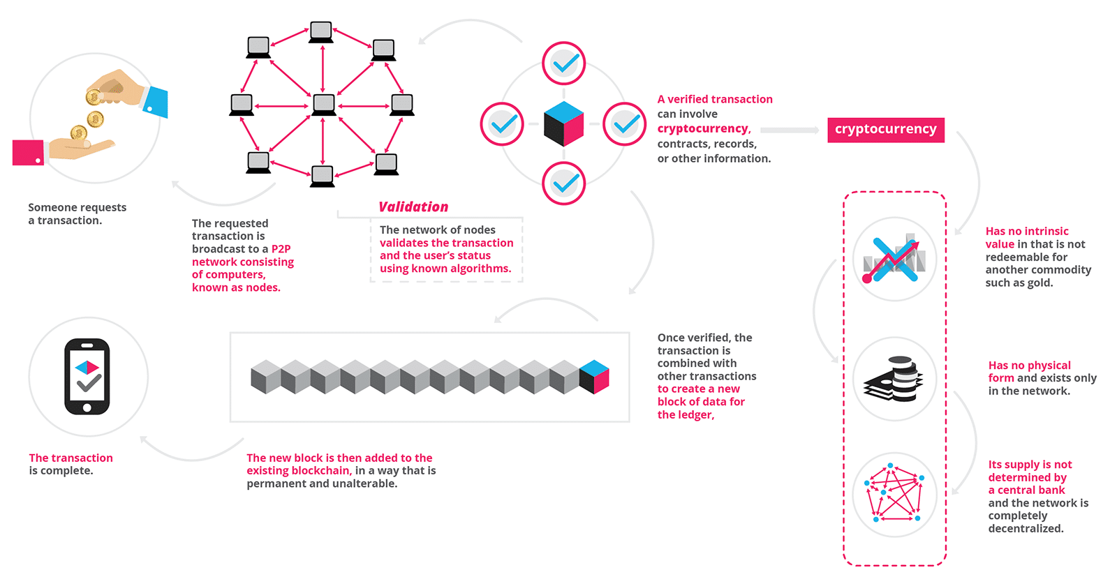
A Transaction

Slide 13
New Cryptocurrency/Lifecycle
Can be generated by code (Open source code can be found in github or other resources)
Lets start with ABC Coin
Initially I have added 500 coin (by code)
If anyone mines (miner), he will get coins as reward up to the limit (lets maximum 1000 coins can be created). Later they will get fee (dollar).
Declare it to the nearest people and ask them to buy with a fixed price (it will be increased day by day). Initial coin offering (ICO).
Adding the coin to the exchange house.
For more funding distribute shares to the people. i.e. Initial Public Offering (IPO).

Slide 14
Trading of cryptocurrency
Illegal in BD
Cryptocurrency Walled
Create account on exchange house
Buy coin by product, service or currency
Buy/Sell coin
Profit will come (mostly you will loose!!!)

Slide 15
Conclusion
Cryptocurrency is the future.
A country (El Salvador) Adopted Bitcoin as an Official Currency
We are at cryptocurrency era from Barter system
Retina Currency is the next.

